Slide 1
My Experience Serving as a
Fulbright Specialist
[CAROL STERLING]
[2012-UGANDA; 2015-INDIA)]
[MARCH 27, 2022, 4:00 PM EST]
[UNIMA-USA VIRTUAL MEMBERSHIP MEETING]
Notes:
We hope that you will continue to share your Fulbright experience, the connections you have made with your host institution, and the long‐term impact of your project with your colleagues and peers after returning from your exchange. You can use this optional presentation template to help share your exchange experience and provide basic information about the Fulbright Specialist Program following your return to the United States. This template can either be used to create a standalone presentation or be adapted as part of a larger presentation.
As you customize this presentation, please note that this template is provided as a tool to help you tell your Fulbright story and highlight your personal experiences. While some general information about the Fulbright Specialist Program is provided to support you in explaining the program, as program policies and procedures are subject to change at any time, we kindly request that program alumni refrain from advising prospective applicants on topics such as submitting a competitive application to the Roster or being matched to a project.
If you receive questions of this nature during your presentation, please feel free to refer individuals to Fulbright Specialist Program staff at fulbrightspecialist@worldlearning.org or encourage individuals to register for an information session at fulbrightspecialist.worldlearning.org

Slide 2
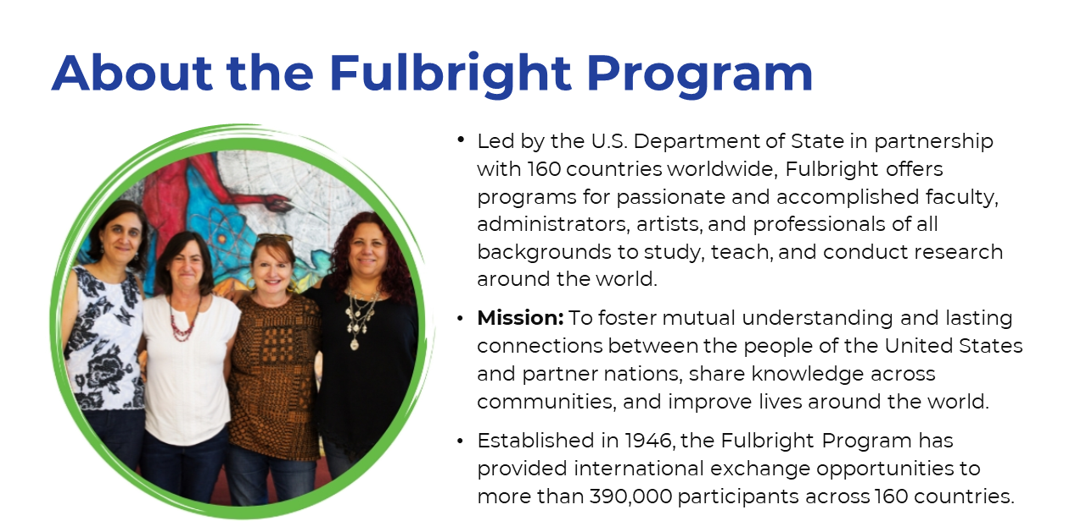
Notes:
The Fulbright Program was founded in 1946 and is led by the United States Department of State in cooperation with 49 Fulbright Commissions and over 100 U.S. Embassies around the world. The goal of the program is to foster mutual understanding between the people of the United States and the people of other countries, using exchange as a means to forge lasting connections between individuals and institutions. Over 390,000 participants from more than 160 countries have received a grant through the Fulbright Program to participate in international exchange.
The Fulbright Specialist Program is only one program that operates under the Fulbright umbrella; other programs are highlighted here: https://eca.state.gov/fulbright/fulbright-programs.

Slide 3
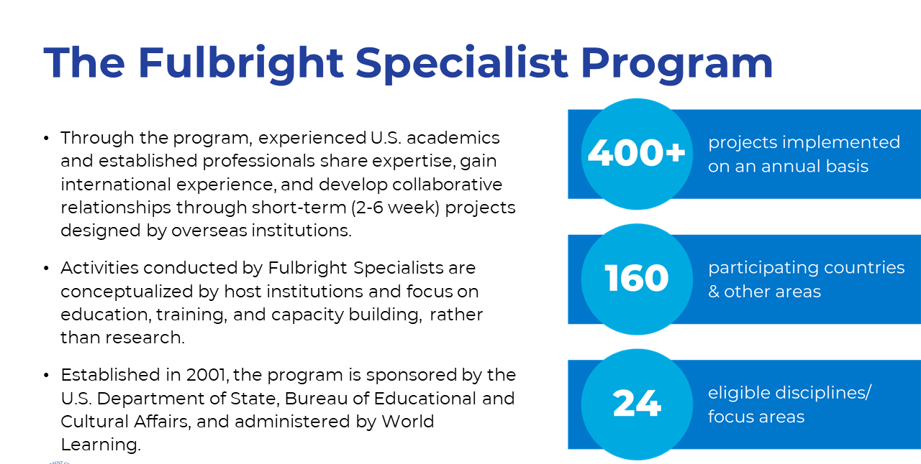
Notes:
The Fulbright Specialist Program was established in 2001. Through the program, overseas host institutions are able to design and implement projects that tackle a key priority or challenge at their institution, and request the support of a U.S. Specialist to provide expert knowledge, assistance, and training to implement the project.
Unlike other exchange programs, the Fulbright Specialist Program is designed to accommodate rapid-response projects on a flexible timeline, and exchanges take place year-round.
Projects are two to six weeks in length, and are focused on education and training activities. Personal research projects are not eligible for funding through this program.
Over 400 Specialists visit institutions in 160 countries and other areas each year, with the goal of sharing their knowledge and expertise, and building connections between their host institution and their place of employment and networks in the U.S.
The Fulbright Specialist Program is implemented by World Learning, an American NGO specializing in global development and exchange programs.

Slide 4
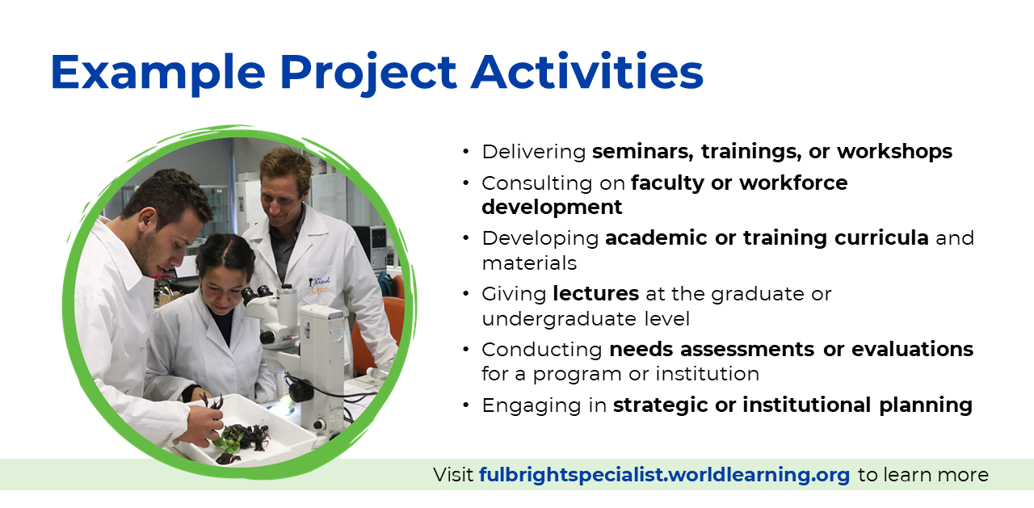
Notes:
The range of activities that Specialists can conduct at their host institutions is very diverse, but all projects include an education or training component.
In many cases, Specialists conduct a range of complementary activities during the grant period. For example, a Specialist may deliver a series of lectures for students, but also spend time advising faculty on curriculum development and developing materials for the host’s use after the grant concludes.

Slide 5
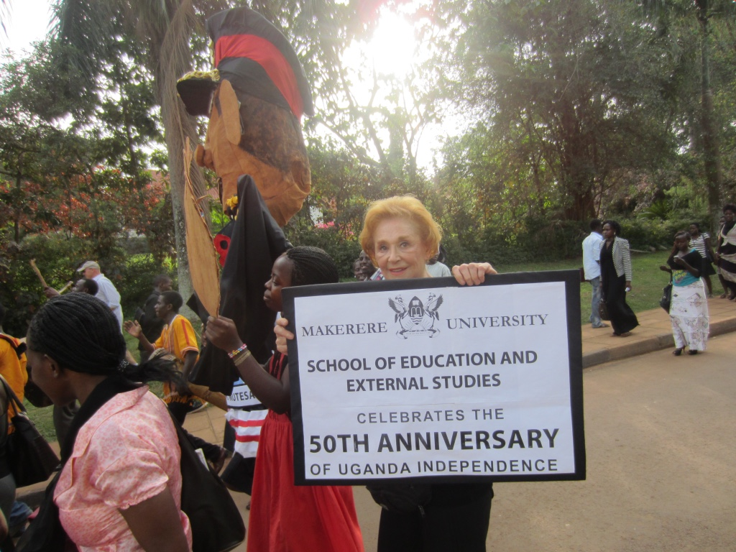
_{Alumni Insight: Carol Sterling}
Host Institutions: Makerere University, Uganda, 2012 ; Ishara Puppet Trust, India, 2015
I chose the Fulbright Specialist Program to share my skills as an educational puppeteer.
I trained pre and in-service teachers in techniques to use puppetry to teach the K-12 Curriculum in each country.
I gained personal gratification in sharing my skills in other cultures.
Notes:
This slide outlines three key topic areas to help you share your Fulbright Specialist experience. On the next three slides, additional considerations and suggestions for each topic area are provided. These slides are intended for you to customize to reflect your own experience and preferences, so please add relevant notes and photographs to each slide prior to delivering your presentation.

Slide 6
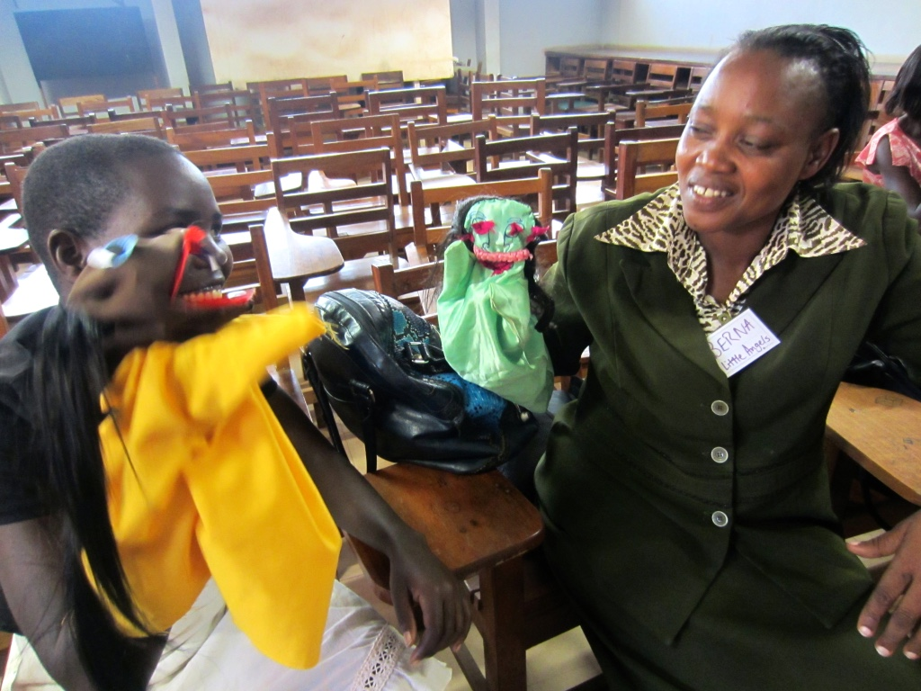
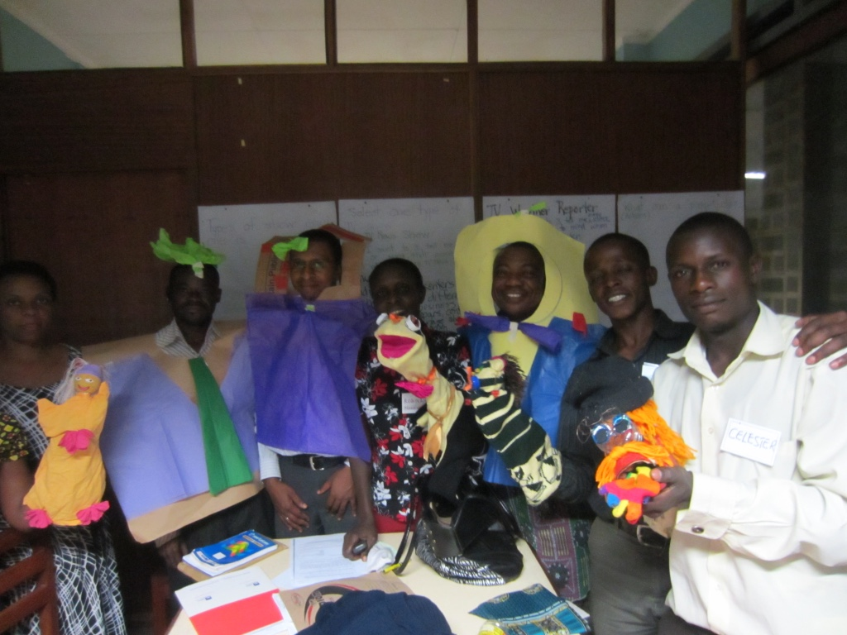
Motivation for Participating
I chose to participate in the program so I could share effective techniques to strengthen student learning of the K-12 Curriculum. Each program was for six weeks.
Notes:
For 60 years plus, my career journey has been as an art teacher, arts administrator, arts advocate and educational puppeteer.
On this slide, you can outline your main professional or personal motivations for participating in the Fulbright Specialist Program. You may also wish to provide additional context regarding your professional background and role at your U.S. place of employment.
Examples of possible reasons for participating to serve as a Specialist could include:
A desire to work with colleagues overseas and access different methodologies or practices in your field;
A desire to develop relationships for yourself or your U.S. employer;
A desire to gain exposure to a different culture/community/country context;
A desire to contribute your skills and knowledge to benefit another institution;
A desire to develop recognition of your expertise within your discipline; or
A desire to serve as a cultural ambassador for the United States.

Slide 7
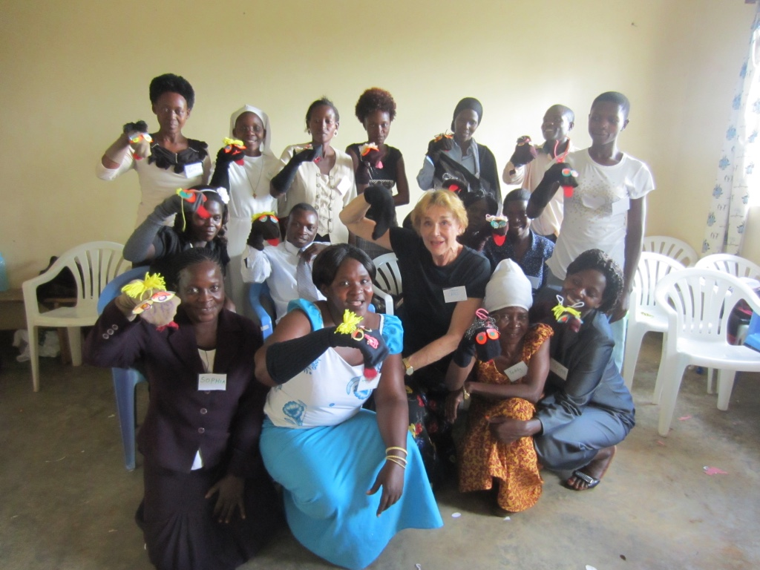
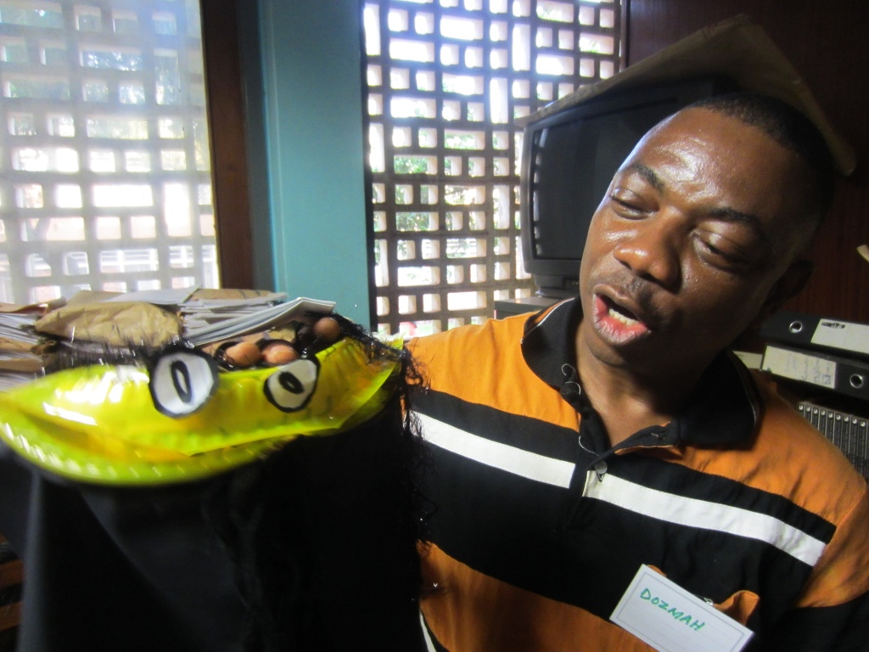
Activities as a Fulbright Specialist
Researched educational standards
Referenced local text books; K-12 curriculum: English/Literacy, Social Studies, Math, Health, Hygiene, Nutrition and Safety and the Arts
Focused on key concepts, knowledge and skills in each curriculum area
Developed puppet construction and prompts for l-5 minute puppet skits created/performed by students
Notes:
On this slide, you can outline key activities that you conducted during your Fulbright Specialist grant. Some suggested topics to discuss might include:
Host institution context – what were the needs that you helped address as a Specialist (i.e. why did your host institution request a Specialist?)
What major tasks or deliverables did you complete during your grant?
What was your day to day experience like?

Slide 8
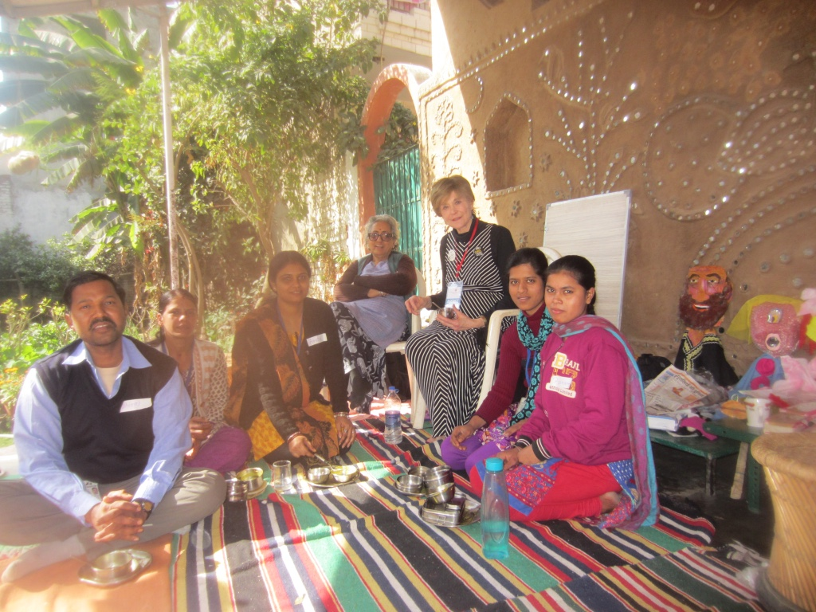
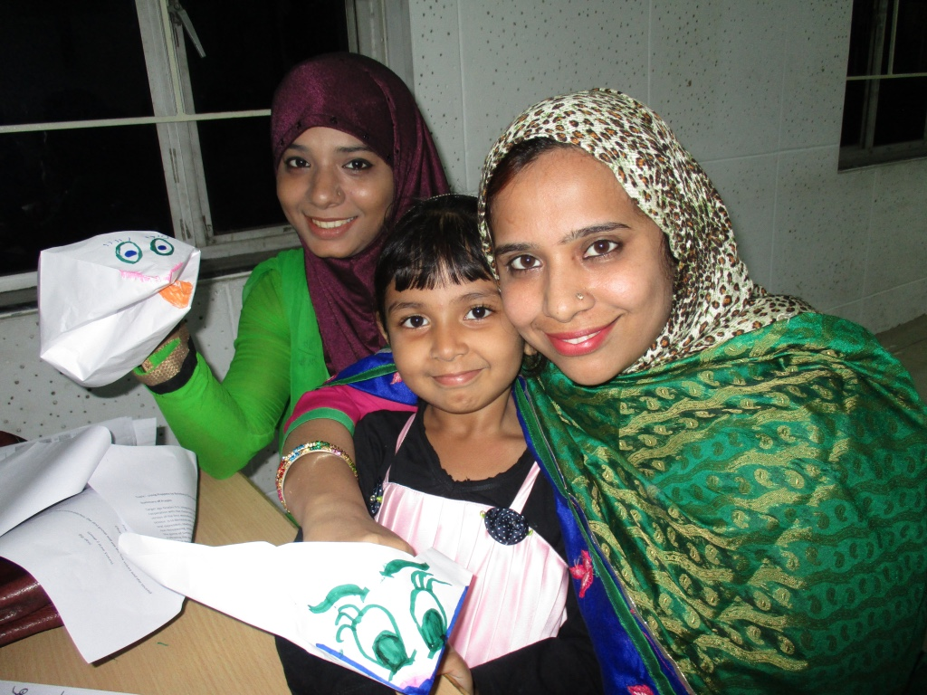
Professional and Personal Outcomes
Personal gratification sharing passion with
colleagues in other countries
Still in touch with students
Notes:
On this slide, you can outline professional and personal outcomes from your grant. Some possible areas to highlight might include:
How have you incorporated any new knowledge or skills gained from your grant in your current professional position?
Did your grant have any positive effect on your career advancement?
Have you continued any formal or informal collaborations with individuals that you met during your grant?
Did you establish or strengthen any institutional linkages following your grant?
How has your experience benefitted others in your professional/personal community or at your place of employment?
Did you experience any personal development such as increased adaptability, confidence, resourcefulness, etc.?

Slide 9

Learn More About the Fulbright Specialist Program
Visit fulbrightspecialist.worldlearning.org to learn more about the program application process and deadlines, and register for an upcoming webinar.
Contact fulbrightspecialist@worldlearning.org with any questions about the program.

